Slide 1




2019 FinAccess Household Survey Key Findings

Slide 2
Presentation Flow
Summary
Key Findings
Questions & Answers
Notes:
FinAccess surveys tracking progress towards financial inclusion in Kenya have been regularly conducted since 2006
The 2016 survey is the fourth, spanning ten years of financial sector development in Kenya
Not only does the survey provide an Empirical basis to track progress on financial inclusion in Kenya. It also
Provides information to the private sector about market opportunities
Provides information to policy makers about the main barriers to access, and options for reforms
Provides data for Academic research into impact on growth and poverty reduction

Slide 3
Key findings
Access Usage Quality Impact
3

Slide 4
Expanding Access
4

Slide 5
Financial Access Journey: 2006 - 2019
Access to formal financial services and products has expanded significantly among Kenyans…
Notes:
Formal financial inclusion has expanded significantly.
Exclusion rate down to 11% in 2019 from 41% 2006 while use of informal sources declined to 6% from 32% in 2006 .

Slide 6
More Kenyans now access formal financial services and products…
Notes:
Formalization of financial services and products key to inclusive growth.
Mobile money has acted as an ‘on-ramp’ for formal financial inclusion - driving digital finance
Inclusion gaps still persist – male/female, education level, wealth quintile, residence

Slide 7
Access gaps still exist, but narrowing…
Notes:
Significant progress in narrowing gap between males and females (sex) and rural/urban divide but economic differences still high in access to financial services and products

Slide 8
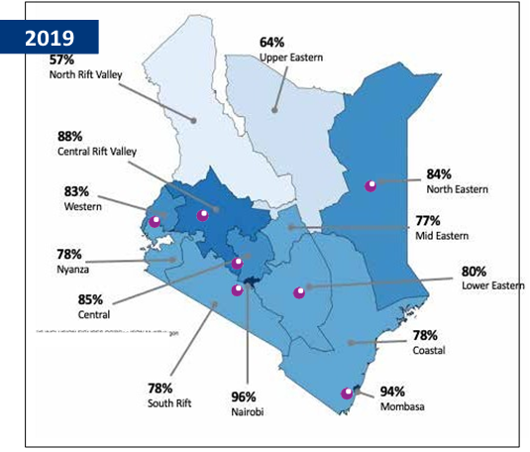
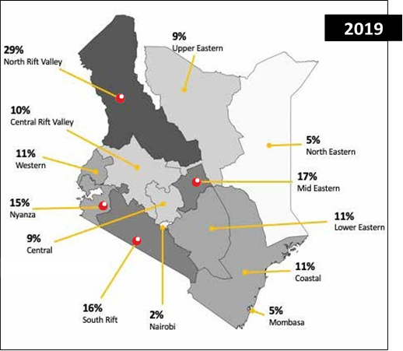
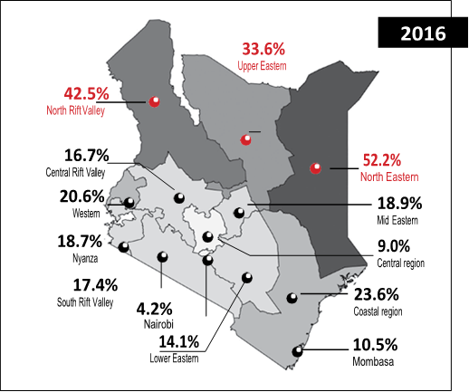
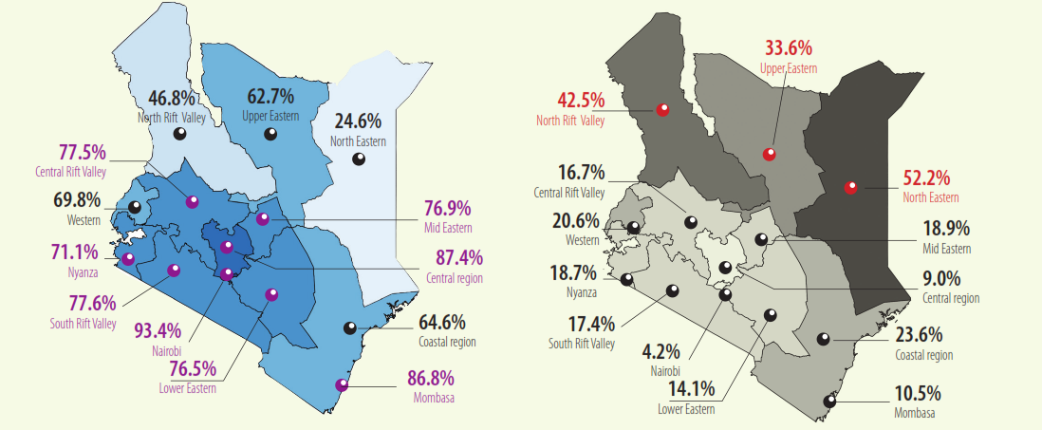
Financial inclusion gaps narrowing, but…
Formal inclusion
Exclusion rate
2016
Notes:
Formalization of financial services and products key to inclusive growth.
Significant drop in exclusion rates of North Eastern, Upper Eastern and Coastal regions.

Slide 9
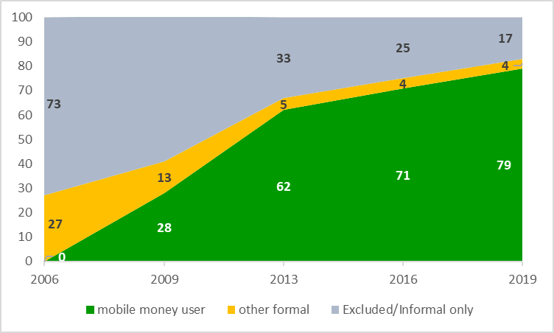
Mobile money is the story behind expanding financial inclusion…
9
Notes:
Rapid uptake of mobile money is key driver to growth in formal inclusion, with almost all those who are formally included having a mobile money account.
While 79% of the population are registered mobile money account holders, 88% of the population have access to mobile money directly or indirectly.

Slide 10
Kenya’s financial inclusion ranks higher across the continent…
Notes:
Kenya is ranked highly in financial inclusion, second only to Seychelles and South Africa

Slide 11
Deepening Usage
11

Slide 12
More Kenyans use a wide menu of financial services and products…
Notes:
Steep decline in MFIs usage could be attributed to increased uptake of digital products – mobile banking, digital app and mobile money.
Note: Pension category includes NSSF; Bank includes traditional banks, mobile banking (e.g. Mshwari, KCB Mpesa, Equitel Money), Post bank and Microfinance Banks; Saccos include deposit and nondeposit taking Saccos; and mobile money includes Mpesa, Mobile Pay, Airtel Money, and T-Kash.

Slide 13
Digitalization raising transactions frequency…
Notes:
Most Kenyans use financial service providers on monthly basis, reflecting salaried employees, remittances to Saccos and loan repayments
High frequency in the use of mobile money, mobile banking and informal sources could imply increasing liquidity needs of the respondents, convenience and ease of access.

Slide 14
More is preferred to less…
Notes:
Kenyans using more than one type of financial service/and product has risen, reflecting interlinkages between mobile money, digital apps and traditional financial services providers.

Slide 15
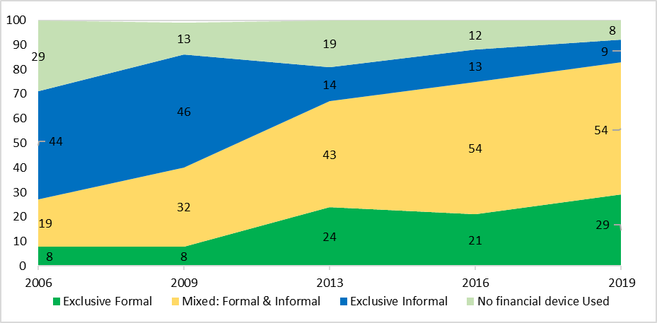
More adults use a mix of formal and informal services and products to meet their growing and complex needs…
15
Notes:
Despite high access level to formal accounts, more than 50% use both formal and informal solutions. This makes sense given the need for a wide range of financial tools that can help manage liquidity, transact and grow.

Slide 16
Young people driving mobile banking. What is the future of traditional banking?…
16
Notes:
Mobile banking usage mainly driven by young people below the age of 35 years.
however that regardless of the age, users combine mobile and traditional banking services.

Slide 17
Mobile banking usage dominates traditional banking…
17
Notes:
Rapid adoption of mobile banking was more among male/urban users at 8 percent growth rate

Slide 18
Challenges and reasons for non-use of bank account vary…
Top reasons for non-use of a bank account
Top challenges cited in bank account usage (%)
18
Notes:
Economic challenges main reason why majority of respondents do not use bank account
System downtime and unexpected changes are main challenges facing bank users

Slide 19

group
groups
groups
Use of Informal Groups still strong – but challenges abound...
>3 groups
Informal Groups Usage by number
Used more than 3 groups
3%
Top challenges in informal Groups Usage (%)
8%
Challenges | 2016 | 2019 | Change
Dishonesty or default by members | 12.0 | 48.7 | 36.7
Theft or fraud by a committee member | 6.2 | 25.6 | 19.4
Theft or fraud by a non-group member | 3.7 | 7.4 | 3.8
Bad investment of funds | 2.9 | 5.1 | 2.2
Use 3 groups
19%
Use 2 groups
70%
Use 1 group
19
Notes:
Dishonesty and/or default and theft/fraud by members major challenge in use of groups

Slide 20
group
groups
groups
Savings moderated but Credit uptake picked up from 2013...mainly digital
>3 groups
Savings and Credit Uptake (%)
Top Reasons for not saving (%)
Use 3 groups
Use 2 groups
Use 1 group
20
Notes:
Challenges in having sufficient amount of money to save and lack of regular income were most hindrance factors to savings among Kenyans
Gap between Savings and credit has narrowed over time

Slide 21
groups
groups
Cost/affordability and preference influence product/service use...
>3 groups
Key Reasons for non-use of a financial provider/product (%)
Use 3 groups
Use 2 groups
Use 1 group
21
Notes:
Main reason for failure to use banks is the lack of affordability or financial situation of households, with the highest score at 77 percent.
People prefer not to use mobile banking for their own reasons

Slide 22
groups
groups
Use of insurance, pension and investments products vary overtime...
>3 groups
Use of Insurance, pension and investments providers (%)
Use 3 groups
Use 2 groups
Use 1 group
Reasons vary for these trends
22
Notes:
NHIF uptake driven by government policy on universal healthcare.
Decline in investments in securities despite nnovations such as M-Akiba requires deeper analysis.

Slide 23
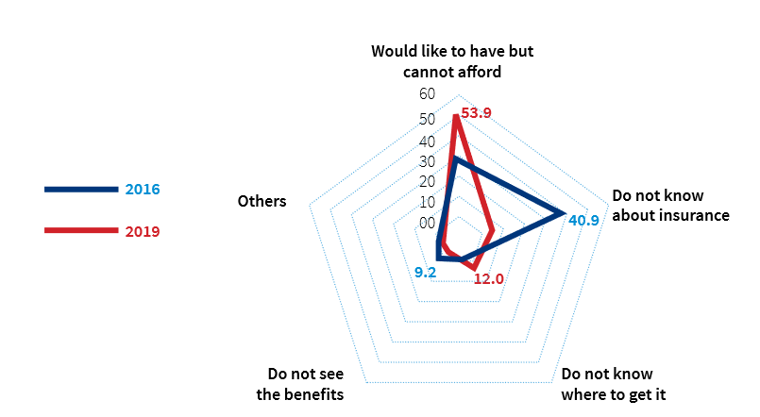
groups
groups
Use of insurance mainly influenced by ability to pay policy premiums...
>3 groups
Top Reasons for lack of Insurance policy (%)
Use 3 groups
Use 2 groups
Use 1 group
23
Notes:
The inability to afford insurance has been cited as the main reason as to why most Kenyans lack insurance cover in 2019 as compared to 2016 where the major reason was lack of understanding insurance products

Slide 24
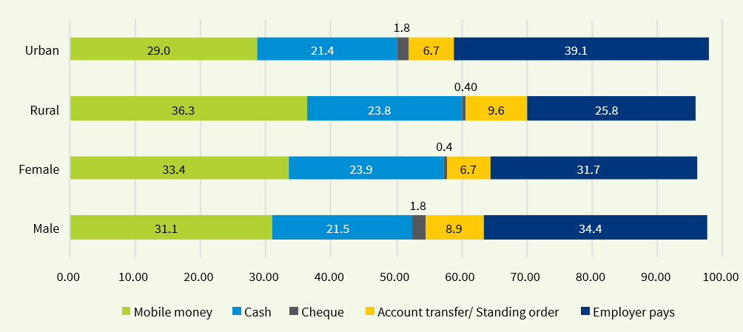
groups
groups
Mobile money device increasingly driving insurance policy premiums payment channels...
>3 groups
Channels for Paying Insurance policy premiums (%)
Use 3 groups
Use 2 groups
Use 1 group
24
Notes:
Mobile money has emerged as a dominant channel for paying insurance premiums, especially in rural areas

Slide 25
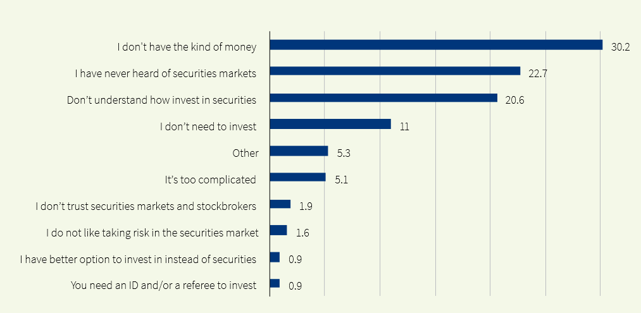
groups
groups
Lack of investible funds and little knowledge are inhibitors to investment in securities...
>3 groups
Top Reasons for not investing in securities (%)
Use 3 groups
Use 2 groups
Use 1 group
25
Notes:
Slightly over 30 percent of the respondents cited lack of money, as the main reason why they cannot invest in securities

Slide 26
groups
groups
Despite rapid digitalization, Cash still remains the most dominant mode of making payments...
>3 groups
Cash dominates all other transaction devices (%)
Cash used widely for daily expenses, monthly bills payments, fee payments, remittances, and purchase of assets
Use 3 groups
Use 2 groups
Use 1 group
26
Notes:
Cash is king in all transactions

Slide 27
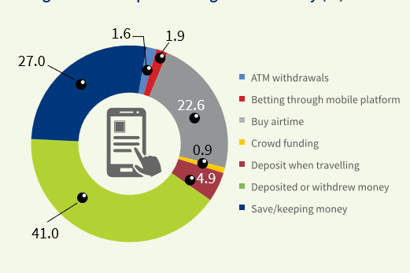
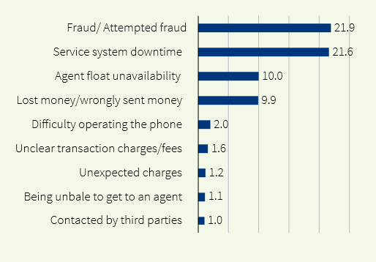
groups
groups
Mobile money usage quite widespread amid emerging challenges...
>3 groups
Purpose of having mobile money
Challenges in using mobile money
Use 3 groups
Use 2 groups
Use 1 group
27
Notes:
Mobile money was mainly used for deposits and withdrawals and safe keeping.
Fraud and system downtime were reported as the main challenges that face users

Slide 28
Relevance: Goals, Needs and Financial Solutions
28
Notes:
As the previous slides have shown, the financial sector has made strong strides in bringing formal financial services to Kenyans, with three quarters of the adult population now having formal accounts.
Given the success in financial access, we need to start asking ourselves, how relevant are these services in people’s daily lives, and to what extent are they contributing to improved livelihoods for Kenyans?
The financial diaries tell us that low-income Kenyan households intermediate 128% of their income through financial devices, and use a median of 14 different financial solutions to accomplish this.
To what extent are formal providers contributing to the rich financial lives of Kenya’s majority? FinAccess is a much cruder instrument than the financial diaries and it cannot answer these questions in detail. However, it can give us some broad brush statistics.

Slide 29
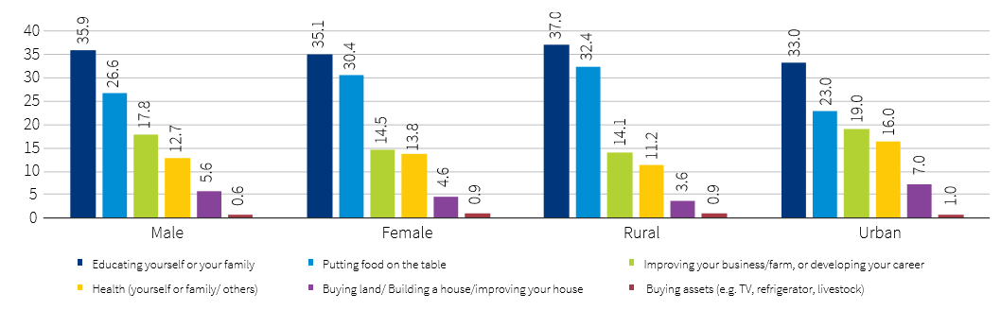
Major priority goal among Kenyans is education and putting food on the table…
Major priority goal by sex and residence (%)
Notes:
Women are slightly more concerned about food, while men are slightly more concerned about livelihood (business/ farming etc.)
significant differences between urban and rural residents in putting food on the table, health and improving livelihoods.
Rural residents prioritize food, while urban residents put priorities on better health and improved livelihood

Slide 30
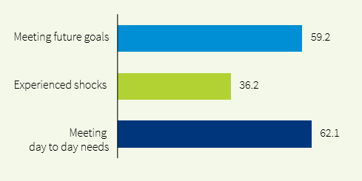
More Kenyans are faced with financial needs towards investment goals, managing shocks and meeting day-to-day expenses...
Proportion of adults mentioning a financial need (%)
Consumers choose financial services and products based on their needs, which are reflected in their use of available solutions either formal and/or informal
Notes:
62% of struggle to meet day-to-day needs in the past 12 months.
59 percent of Kenyans are working towards meeting their future goals

Slide 31
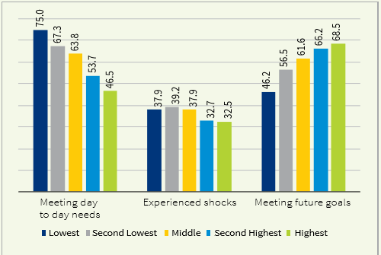
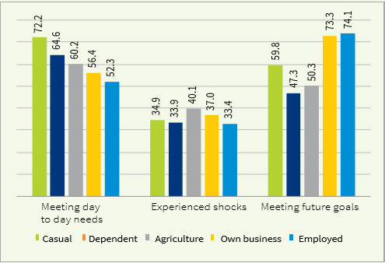
Kenyans’ socio-economic status and livelihood resilience largely influenced by how they meet their needs…
Needs by wealth quintiles (%)
Needs by livelihood sources (%)
Notes:
Meeting day-to-day needs and keeping money aside for future goals depends on socio-economic status and resilience of income sources

Slide 32
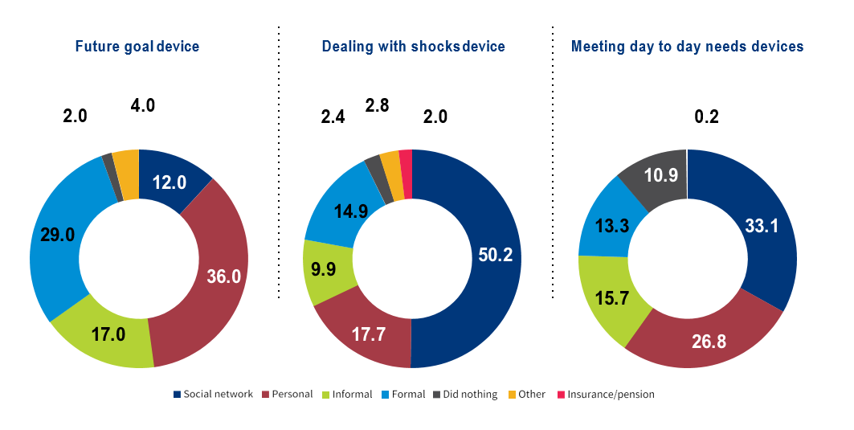
Financial solutions vary with the need…
Financial solutions used towards meeting financial needs
NOTES
Social networks = | Borrow from friends and family
Personal = | Sell assets/livestock/poultry, get additional work, cut back on expenses
Formal = | Use savings or borrow from formal institutions such as banks/MFIs/ SACCOs, excluding insurance
Informal = | Borrow or savings from informal providers such as shylocks, Chama, employers, shopkeeper, secret hiding place

Slide 33
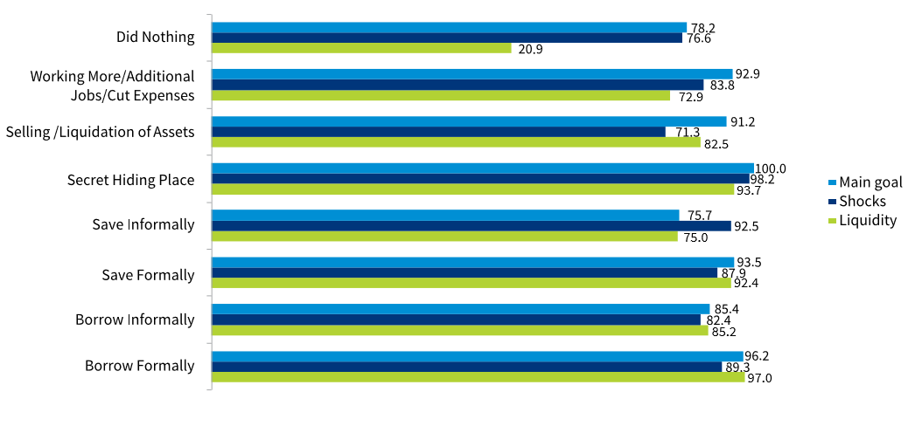
Both financial and non-financial solutions are used widely in addressing a financial need…
Effectiveness on the use of selected solutions (%)
33
Notes:
On how effective the choices were, most Kenyans reported that the formal financial solutions were effective in keeping money aside to meet future goals. Informal savings were considered as most effective in meeting day-to-day needs

Slide 34
Financial Health and Livelihoods
Notes:
Financial health refers to the ability of Kenyans to use financial services for managing daily needs, protecting themselves from shocks and helping to achieve their main goals.
It is measured through a multidimensional financial health index covering three dimensions ability to manage everyday finances, ability to cope with risk and ability to invest in livelihoods and future

Slide 35
Financial health worsened in 2019 ….
Financial Health Dimensions (%)
Financial Status (%)
Overall
Notes:
The financial health index across the population shows a marked decline since 2016.
This may be because of a general tightening of economic conditions for many- reflected also in a higher proportion who say their financial lives have worsened.
Statistical abstract (2018) also shows some indications of economic stress across different sectors as well as price increases in food and fuel…
The price index of food and non-alcoholic beverages increased by just under 16% from January 2016 to December 2017 (TABLE 3.20) This seems to have particularly affected low income urban dwellers with in increase in the price index for the low income population of Nairobi of just under 20%
The average price of petrol (super) increased by just under 11% from 2016 to 2017 (TABLE 3.21)
Public sector earnings growth from agriculture and forestry slowed to 1.5% between 2016 - 2017. The average year on year growth between 2013 and 2017 was 10.7% (TABLE 3.8)
Wage employment in private agriculture, forestry and fishing fell by around 1.6% (TABLE 3.3a)
0.6% year on year decrease in earnings in the public sector from manufacturing. This compares with an average year on year increase of 11.2% between 2013 - 2016

Slide 36
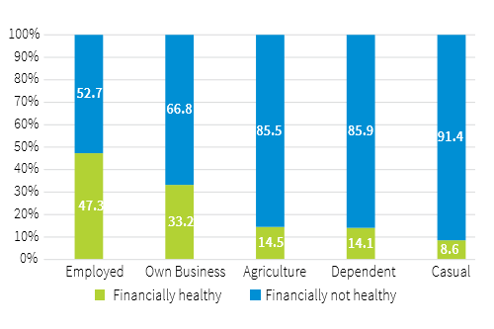
Being in formal employment and or running business impacts financial health…
Financial health by livelihood in 2019 (%
Notes:
Adult population with formal employment and or owning a business were more financially healthy compared to the those engaged in other sources of livelihood

Slide 37
Perceptions on Consumer Protection and Financial Literacy
37

Slide 38
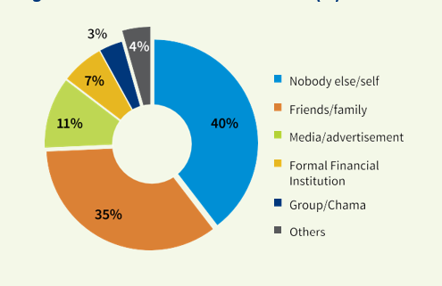
Financial advice gaps exist…
Sources of financial advice (%)
respondents relying on their own knowledge was 39.6% compared to 34.7% who relied on family and friends for financial advice…huge opportunity for financial advisors!
Notes:
Financial literacy is a combination of awareness, knowledge, skill, attitude and behaviour necessary to make sound financial decisions.
Sources of financial advice for individuals are indicative of attitude and trust in an institution(s) or person(s).

Slide 39
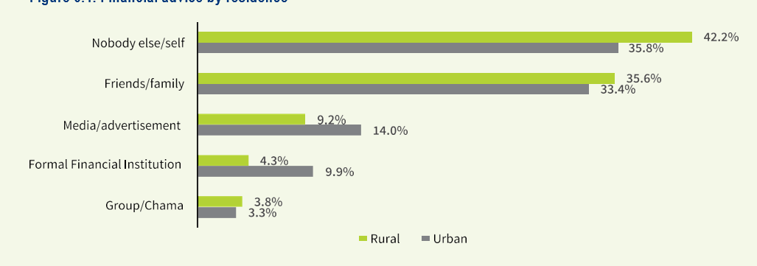
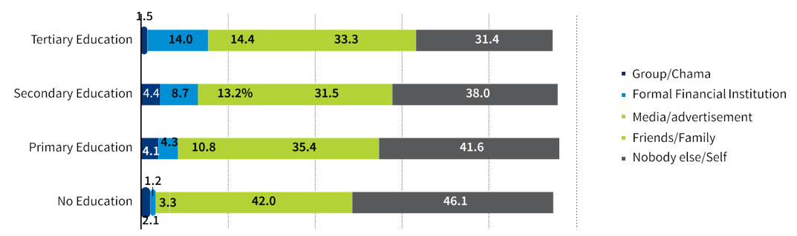
Formal education greatly impacts choice of financial advice …
Sources of financial advice by Residence (%)
Sources of financial advice by Education (%)
Notes:
residents in rural areas (42.2 %) depend on their own knowledge in decision making on financial matters compared to 35.8 percent in urban areas
46.1% of the population with no education and 41.6% with primary education relied on their own knowledge, in decision making on financial issues

Slide 40
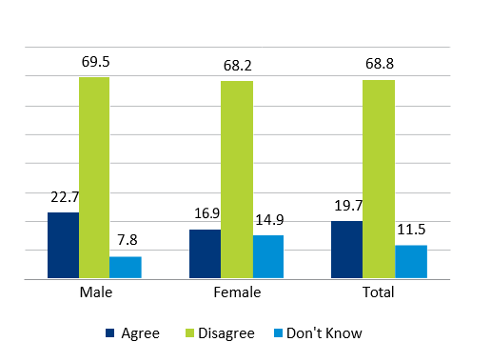
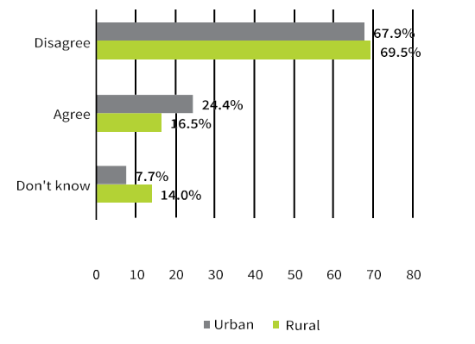
About 70% of Kenyans perceive betting not to be a good source of income, but 20% have a positive view …
Perception on Betting/Gambling (%)
Perception on Betting/Gambling as a good Source of Income (%)
Notes:
Only 20 percent of the adult population considered betting as a good income source.
More Kenyans in rural areas (69.5%) than 67.9 percent in urban areas do not consider gambling as good way of making money

Slide 41
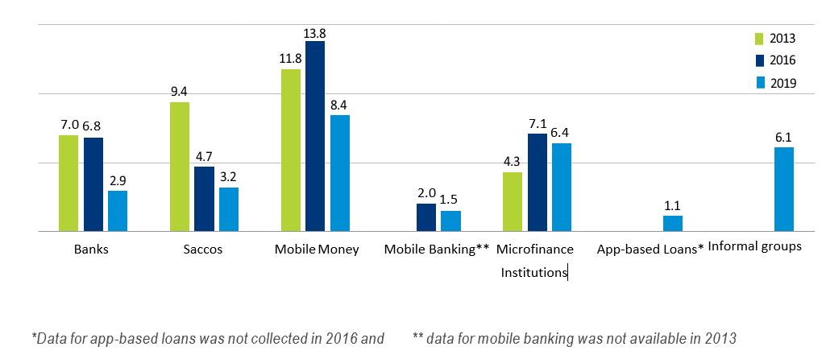
Easing Consumer Protection Concerns….
Consumers loss of money by institutions: 2016 - 2019 (%)
Notes:
Consumer protection practices entail maintaining financial system integrity and safeguarding consumers against malpractices such as fraud, unfair pricing and lack of complaint resolution.
a downward trend in the instances of lost money by type of institution or device.
Mobile money reported the highest incidence of money lost over all the three surveys.

Slide 42
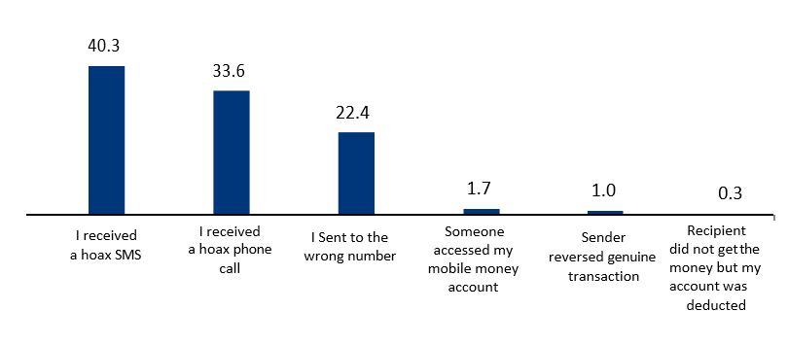
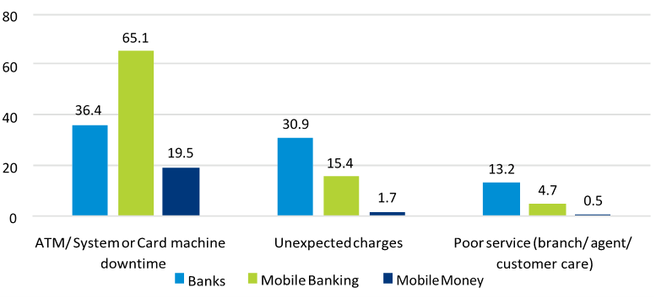
Consumer Protection Concerns….
Loss via Mobile money: 2016 - 2019 (%)
Challenges experienced on financial services used (%)

Slide 43
Summary and Conclusions
Digital transformation via mobile banking and digital apps space raises cyber security, credit risk and consumer protection concerns.
Cash is a still the dominant mode of payment for agriculture and business
Majority of Kenyans feel that their financial status has worsened, implying reduced ability to use financial services and products to manage their daily needs, cope with shocks and achieve future goals.
Promotion of financial literacy is important in addressing emerging consumer protection concerns.
Fraud accounted for the highest incidences of loss of money on mobile money platforms, thus becoming a source of new emerging risks.

Slide 44
Questions & Answers

