Slide 1


FinAccess MSE Tracker Survey 2023
Key highlights of findings
10th March 2023
By Macdonald G. Obudho, MBS
Director General, KNBS

Slide 2
Outline
  Background to MSEs survey
  Survey methodology
  Findings
  Conclusion

Slide 3
Background to FinAccess Tracker Surveys
FinAccess Surveys
Survey monitors developments and progress in the financial sector to gain a better understanding of the inclusivity and overall dynamics of Kenya’s financial landscape.
FinAccess Household sample surveys - 2006, 2009, 2013, 2016, 2019 and in 2021.
Focus on four dimensions namely; Access, Usage, Quality, Impact
Why MSE Tracker Surveys? FinAccess provides a rich sample for understanding micro businesses filling information gaps that most studies are unable to capture, because of the nature of these MSEs
  Track and assess policy impact; (MSE COVID-19 tracker survey)
  Inform targeted service and product delivery –for MSEs sector
MSEs Tracker Surveys - a deep-dive to livelihoods approach to inclusive finance - focus on individuals whose main source of income is own business/self employment.

Slide 4
MSEs Tracker Methodology
Survey sample
Findings based on 2,394 respondents drawn from FinAccess 2019 and FinAccess 2021 surveys that met the following criteria;
    Main source of income is own business/self employment
    Consented to follow-up surveys during the main FinAccess survey
    Provided an active telephone number, and successfully connected(network)
    Completed telephone interview
Therefore, survey sampling is non-probability based on: respondents’ availability, willingness to participate, and accessibility via mobile phone provided.
Data collection
  Data collected between October – November, 2022
  Telephone interviews - Computer Assisted Telephone Interview(CATI).

Slide 5
Findings - Profile of MSEs that Participated in the Survey
Majority (70%) of MSEs are owner operated (no employees).
Women constitute 60.2% of respondents (MSEs) in the survey
Sectors mainly in wholesale and retail trade(63.1) and agriculture based business activities (8.9%).

Slide 6
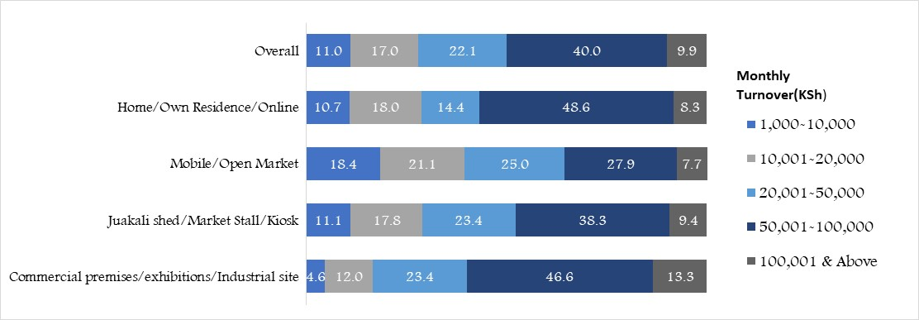
Profile of MSEs that Participated in the Survey
MSEs monthly turnover
Findings on indicate that 11% of MSEs in the survey had a monthly turnover of less than KSh 10,000.
At least half of sample reported monthly turnover below KSh 50,000.
Higher monthly turnover (KSh 50,000 and above) was reported by MSEs in commercial premises/exhibitions (60%) and those operating at home/online/own residence (57%)

Slide 7
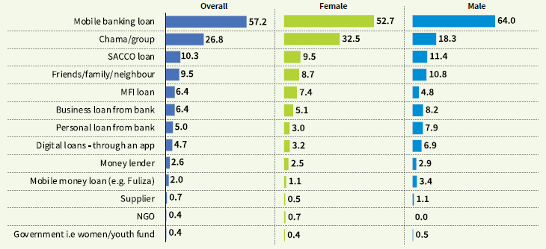
Access to Loans
Mobile banking loans emerged as the dominant source of credit by MSEs, at 57.2 percent from 45 percent in 2020 (MSE COVID-19 tracker)
Borrowing from informal sources ( Chamas/groups and family/friends) was found to be high among MSEs)
In addition to loans, 36.7% of MSEs depend on trade credit from suppliers

Slide 8
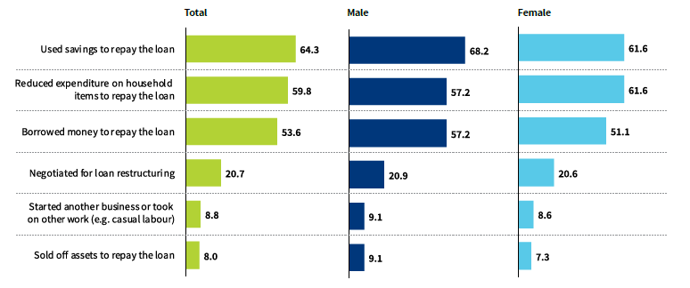
Loan default, and sources of money to repay loans
Percentage Borrowers who reported loan defaults by source of loan
(default means Missed/delayed a payment, Never paid loan or Paid late)
Most MSEs use savings, cut expenses on household expenditures, and borrow to repay loans
More than half (53.6%) of MSEs borrow to repay loans
Other sources of money to repay loans (excluding income from business)

Slide 9
Reasons for taking loans
The top reasons for taking loans is to purchase stock, run the business, and repay other loans.

Slide 10
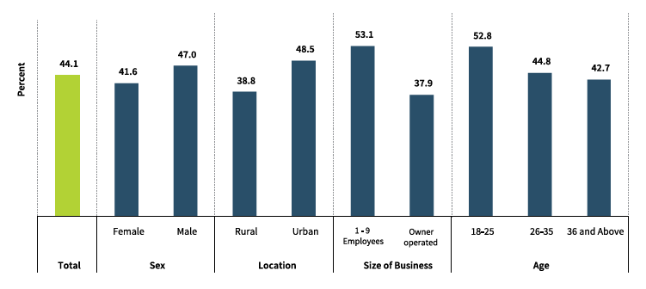
Digitization of customer payments
MSEs (%) that have digitized customers payments
Digital payments: mobile money(send money/paybill/buy goods),
Digital record keeping for business facilitates access to credit.
44.1 percent of MSEs had use a digital payment for payment of goods and services by customers.
Use is higher for male MSE owners(47%) compared to females(42%)

Slide 11
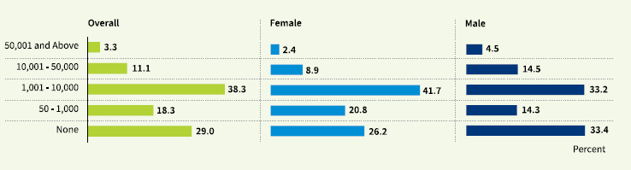
Consumer credit provided by MSEs
The survey sought to assess the value of the outstanding consumer credit advanced by the MSEs to their customers.
Overall, among the 71% of MSEs that provide consumer credit, 38.3 percent of MSEs were owed consumer credit valued at KSh 1,001 - KSh 10,000
Outstanding consumer credit(in KSh) advanced by MSEs

Slide 12
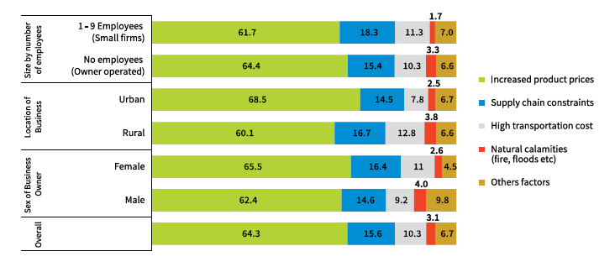
Challenges in accessing supplies
The most cited challenge in accessing supplies is increased product prices (64 % of all MSEs) and supply chain constraints(15.6%)
Other challenges faced by MSEs are highlighted in report.
Challenges

Slide 13
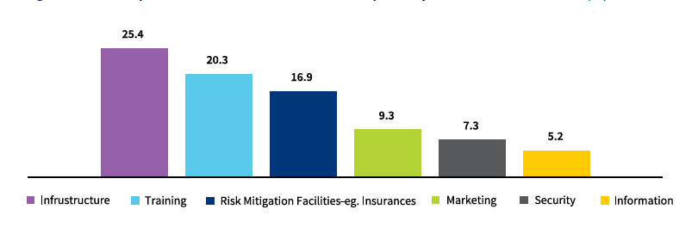
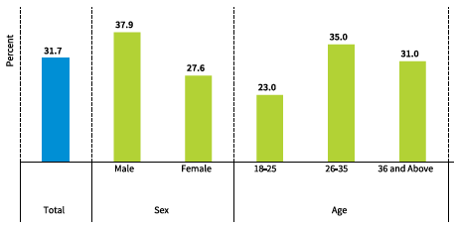
Training and interventions MSEs need ….
Skills gap exists for business owners in MSEs
31.7% of owners of MSEs have received training in their areas.
Infrastructure (25.4%) and training (20.3%) were the most cited support required from Government
Proportion of business owners(%) trained in their area of business
Types of Non-financial assistance required by MSEs(%) from Government

Slide 14
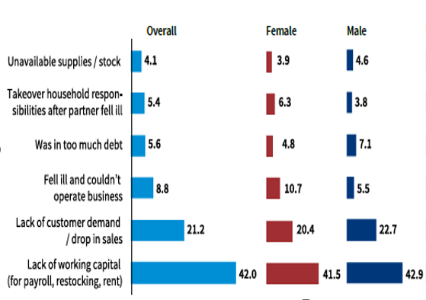
Closed businesses – open in 2021, but closed in Nov 2022
Main reasons for business closure
Lack of working capital and customer demand are cited as main reasons for business closure by 42% and 21.2% of MSEs, respectively.
More women entreprenuers closed their businesses due to illness(10.7) compared to men (5.5).

Slide 15
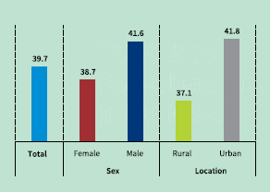
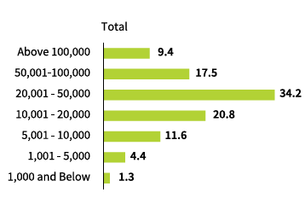
Closed businesses…
More than 50% of business owners that had closed businesses reported that they require capital of KSh 20,000 and above to reopen
Findings indicate that 39.7% of business owners that closed tried to get working capital before closing.
Percentage Businesses that tried to source for working capital before closing
Percentage of MSEs by amount (KSh) required to reopen closed business

Slide 16
Conclusion
Findings highlight financial inclusion gaps and challenges across various MSEs segments.
Results will inform future monitoring of policies, programmes, product development and actions that address infrastructural, supply chain issues by MSEs.
Looking forward, in the next waves, we should be able to track the impact of the new innovations such as the financial inclusion fund (Hustlers Fund).

Slide 17

Thank you
Detailed findings in full report accessible in KNBS, CBK and FSD-K websites.

